Slide 1

IDENTIFYING LEADING CASTS IN MOVIES USING NEURAL NETWORK MODELS
Submitted by - Md. Musharraf Md. Hamid Rashid Aziz
Guided by-
Dr. Tanvir Ahmad

Slide 2
M I N O R
P R O J E C T
D E P A R T M E N T
O F C O M P U T E R E N G G .
I n d e x
Objective Motivation
What we plan to do Methodology
Benchmarks
Future Extension Technology Used References

Slide 3
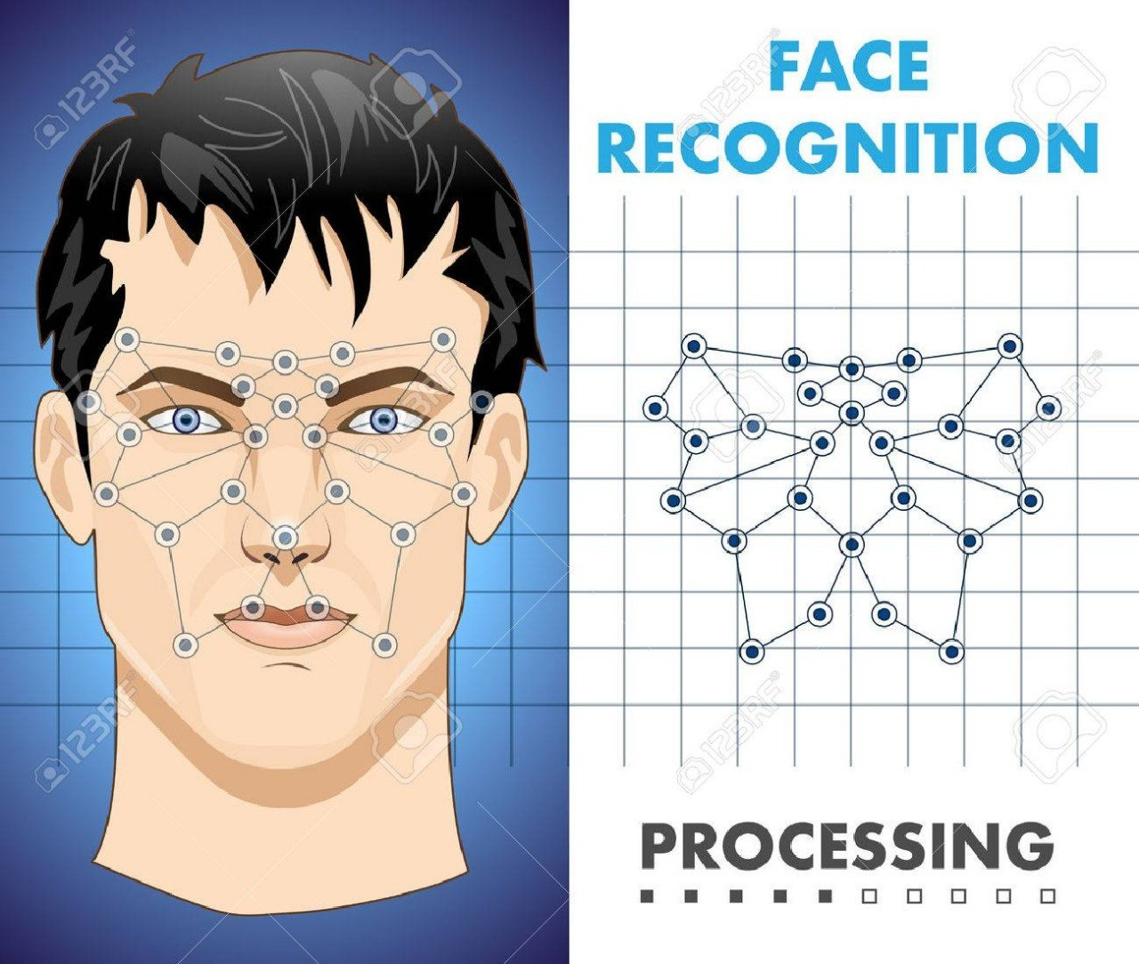
OBJECTIVE
The Objective of our
Project is to design a
software that can
detect and recognize
human faces from an Film.

Slide 4
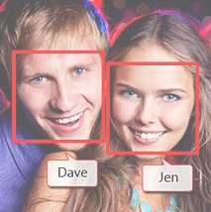
M O T I V A T I O N
Recognizing human faces in wild is emerging as a critically important and technically challenging computer vision problem. With a few notable exceptions, most previous works in the last several decades have focused on recognizing faces captured in a laboratory setting. However, with the introduction of databases, face
recognition community is gradually shifting its focus on much more challenging unconstrained settings.
W W W . C L U S T E R . C O M

Slide 5
WHAT WE PLAN TO DO
O u r P l a n i s t o c r e a t e a d a t a b a s e h a v i n g i m a g e s o f f a m o u s
I n d i a n a c t o r a n d a c t r e s s . W e w i l l t h e n t a k e t h e s c r e e n s h o t s o f m o v i e s a t t h e f i x e d t i m e i n t e r v a l a n d w i l l m a t c h t h e
s c r e e n s h o t s w i t h o u r d a t a b a s e a n d p r e d i c t t h e l e a d a c t o r a n d a c t r e s s i n t h e f i l m . O u r d a t a b a s e c o n s i s t s o f f a c e s o f m a n y
k n o w n a c t o r s c o l l e c t e d f r o m t h e i r k n o w n m o v i e s . U n l i k e o l d m e t h o d s w h i c h u s e d f a c e d e t e c t o r s t o a u t o m a t i c a l l y d e t e c t
t h e f a c e s f r o m t h e w e b c o l l e c t i o n , i m a g e s i n o u r d a t a b a s e a r e g e n e r a t e d m a n u a l l y f r o m t h e m o v i e s . T h i s w i l l r e s u l t i n a
h i g h d e g r e e o f v a r i a b i l i t y ( p o s e , e x p r e s s i o n , i l l u m i n a t i o n , a g e , m a k e u p ) w h i c h o n e c o u l d e v e r s e e i n t h e n a t u r a l w o r l d .

Slide 6


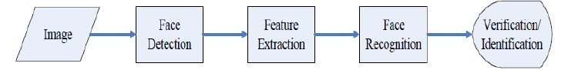
HOW WE PLAN TO DO
O U R M E TH O D C O M E S WI TH C O LLE C TI N G D E TAI LE D
AN N O TATI O N I N TE R M S O F AG E , B O U N D I N G B O X , M O VI E R E LE AS E , E X P R E S S I O N , G E N D E R , P O S E , M AK E U P , AN D
P O S S I B LE K I N D O F O C C LU S I O N . TH E D ATAB AS E I S D E S I G N E D
TH R O U G H F O LLO WI N G S TE P S :
S E LE C TI O N O F M O VI E S AN D AC TO R S
M AN U ALLY P R E P AR I N G TH E D ATAB AS E O F S E LE C TE D AC TO R / AC TR E S S
P R U N N I N G O F D ATAB AS E
C O N TD .

Slide 7

Proposed Method
S E L E C T I O N O F F R A M E S F R O M V I D E O S C R O P P I N G A N D D E T E C T I O N O F F A C E S P R U N I N G O F T H O S E I M A G E S I N W H I C H F A C E S C O U L D N O T B E D E T E C T E D
M A T C H I N G T H E F A C E S W I T H T H E I M A G E S P R E S E N T I N T H E D A T A B A S E
G I V I N G A N A L Y S I S O F T H E L E A D C A S T P R E S E N T I N T H E F I L M

Slide 8


M E T H O D S I G H T H O U N D | B E N C H M A R K S | A C C U R A C Y % 9 9 . 2
D R M |  | 8 9 . 9
S S D M L |  | 8 8 . 8
R N P |  | 8 8 . 6
M S S R C |  | 8 5 . 6
F A C E + + |  | 8 4 . 1
S A N P |  | 8 0 . 4
O P E N C V |  | 4 9 . 6

Slide 9
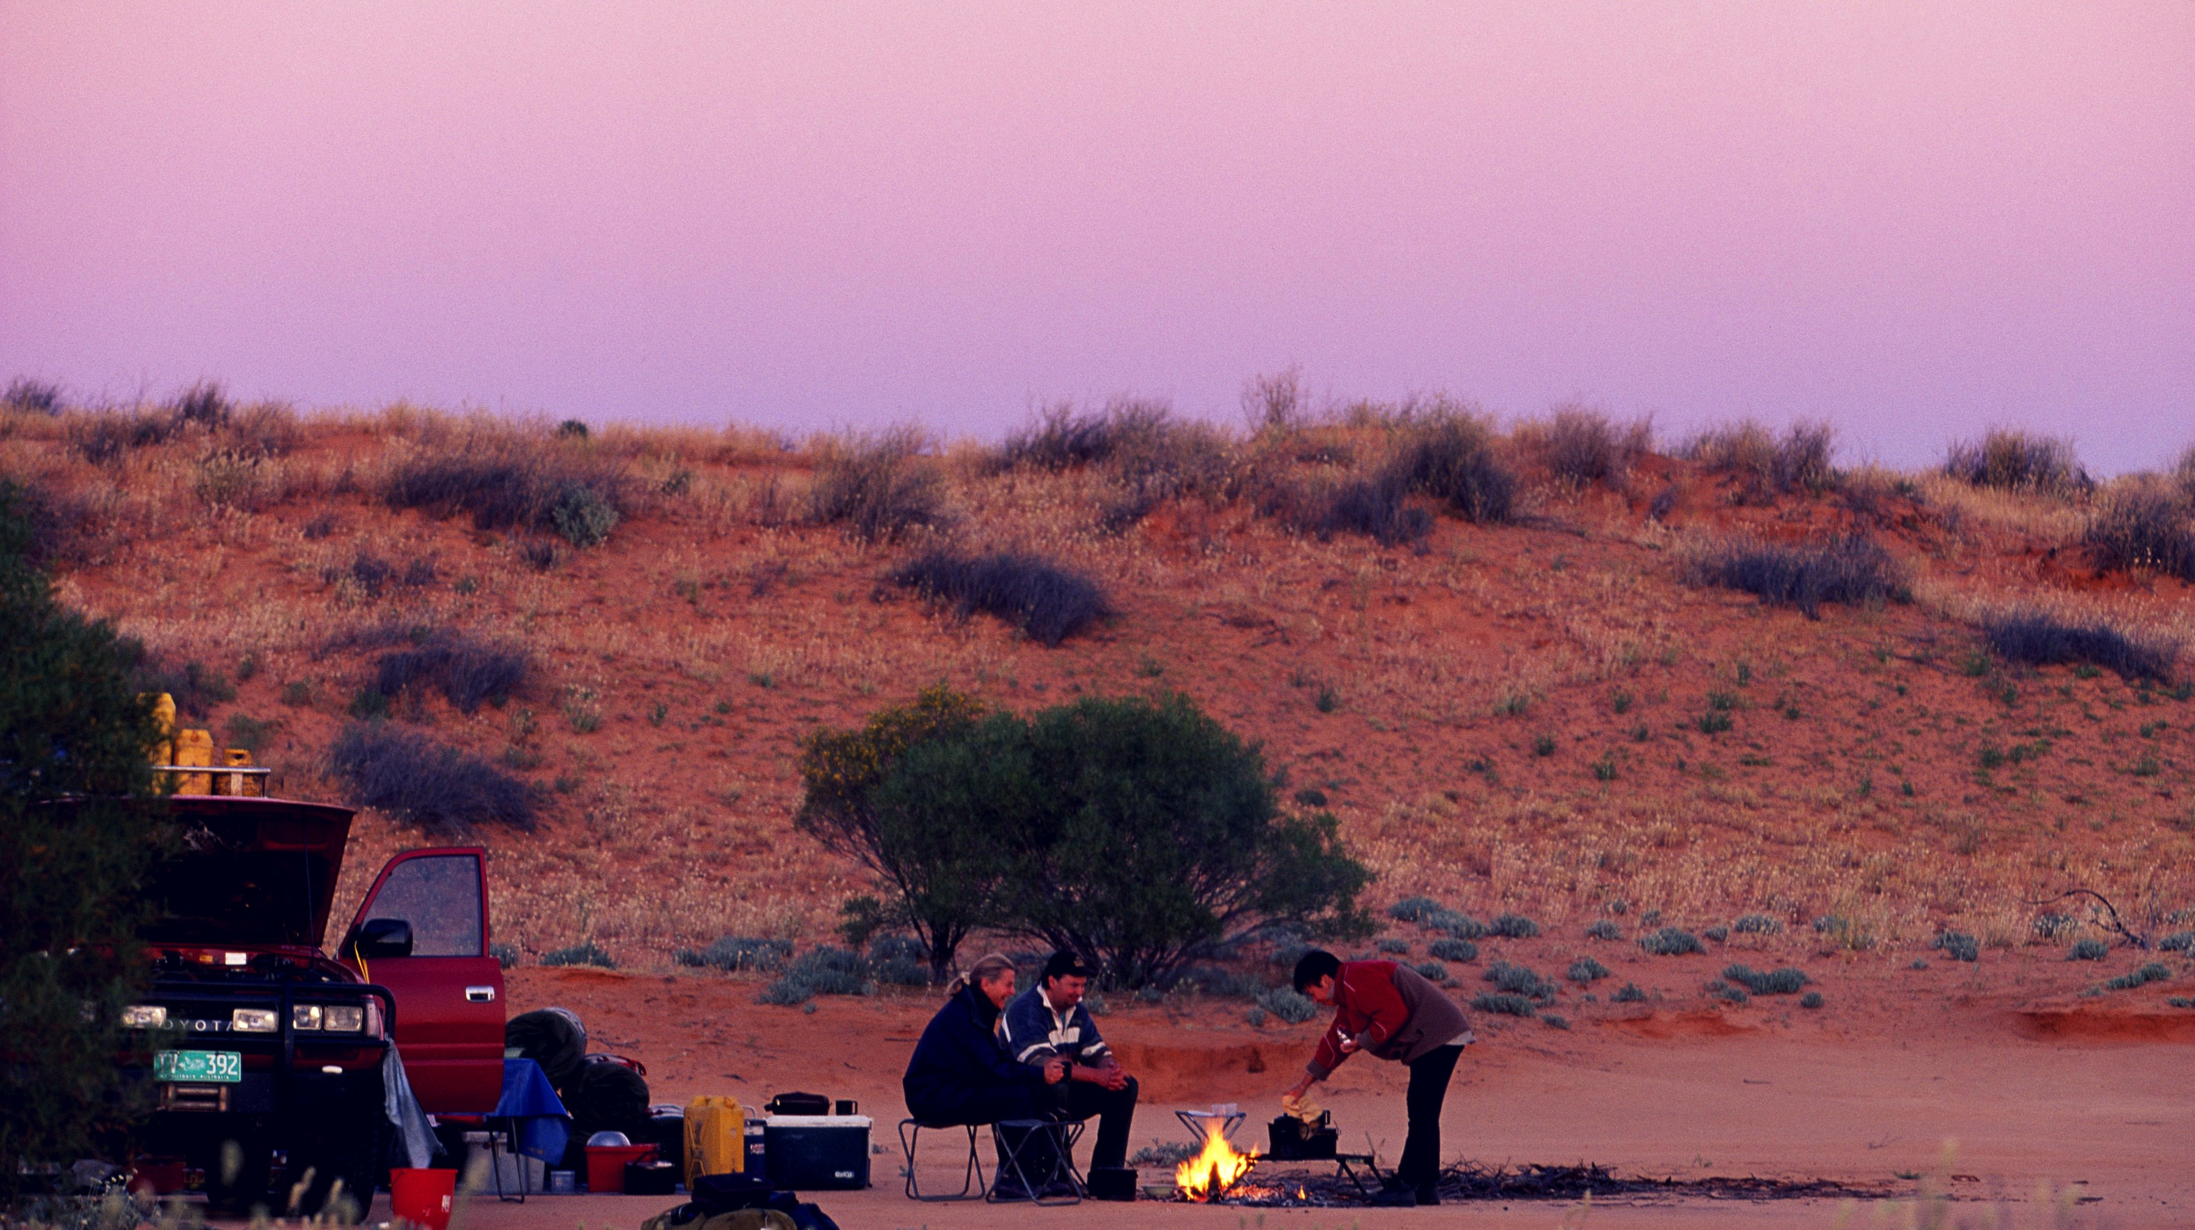
F U T U R E E X T E N S I O N
1 . R E A L T I M E C C T V / A N Y L I V E S T R E A M I N G D E V I C E F O O T A G E
A N A L Y S I S F O R C O N V I C T I D E N T I F I C A T I O N
2 . I D E N T I F I C A T I O N O F L O S T P E R S O N S
3 . C R O W D D E M O G R A P H I C S U R V E Y

Slide 10



Technology Used
P Y T H O N O P E N C V
T E N S O R F L O W S C I K I T - I M A G E P A N D A S
K E R A S
M A T P L O L I B

Slide 11
M I N O R
P R O J E C T
D E P A R T M E N T
O F C O M P .
E N G G .
R E F E R E N C E S
1. Understanding Face Recognition, Vicki Bruce, Andy Young
https://onlinelibrary.wiley.com/doi/abs/10.1111/j.2044-8295.1986.tb02199.x 2. Face recognition: A literature survey, W.Zhao, R.Chellappa, P.J Philips,
A.Rosenfeld
https://dl.acm.org/citation.cfm?id=954342
3. Supervised kernel locality preserving projections for face recognition,
Jian Cheng, Qingshan Liu, hanging Lu
https://www.sciencedirect.com/science/article/pii/S0925231204005594

Slide 12
THANK YOU

